Slide 1
Computer Networks CS 3001 (BCS-5B) Lecture 3
Danyal Farhat
FAST School of Computing
NUCES Lahore

Slide 2

Chapter 3: roadmap
Transport-layer services
Multiplexing and demultiplexing
Connectionless transport: UDP
Principles of reliable data transfer
Connection-oriented transport: TCP
Principles of congestion control
TCP congestion control

Slide 3
rdt2.0: corrupted packet scenario
rdt_send(data)
snkpkt = make_pkt(data, checksum)
udt_send(sndpkt)
rdt_rcv(rcvpkt) &&
isNAK(rcvpkt)
sender
Wait for call from above
Wait for ACK or NAK
udt_send(sndpkt)
rdt_rcv(rcvpkt) && corrupt(rcvpkt)
udt_send(NAK)
rdt_rcv(rcvpkt) && isACK(rcvpkt)
Wait for call from below
Λ
receiver
rdt_rcv(rcvpkt) && notcorrupt(rcvpkt)
extract(rcvpkt,data)
deliver_data(data)
udt_send(ACK)

Slide 4
rdt2.0 has a fatal flaw!
what happens if ACK/NAK corrupted?
sender doesn’t know what happened at receiver!
can’t just retransmit: possible duplicate
handling duplicates:
sender retransmits current pkt if ACK/NAK corrupted
sender adds sequence number to each pkt
receiver discards (doesn’t deliver up) duplicate pkt
stop and wait
sender sends one packet, then waits for receiver response

Slide 5
rdt2.1: sender, handling garbled ACK/NAKs
rdt_send(data)
sndpkt = make_pkt(0, data, checksum)
udt_send(sndpkt)
rdt_rcv(rcvpkt) && (corrupt(rcvpkt) ||
isNAK(rcvpkt) )
Wait for call 0 from above
Wait for ACK or NAK 0
udt_send(sndpkt)
rdt_rcv(rcvpkt)
&& notcorrupt(rcvpkt) && isACK(rcvpkt)
rdt_rcv(rcvpkt)
&& notcorrupt(rcvpkt)
&& isACK(rcvpkt)
Λ
Λ
Wait for ACK or NAK 1
Wait for
call 1 from above
rdt_rcv(rcvpkt)
&& (corrupt(rcvpkt) ||
isNAK(rcvpkt) )
rdt_send(data)
udt_send(sndpkt)
sndpkt = make_pkt(1, data, checksum)
udt_send(sndpkt)

Slide 6
rdt2.1: receiver, handling garbled ACK/NAKs
rdt_rcv(rcvpkt) && notcorrupt(rcvpkt)
&& has_seq0(rcvpkt)
extract(rcvpkt,data)
deliver_data(data)
sndpkt = make_pkt(ACK, chksum)
udt_send(sndpkt)
rdt_rcv(rcvpkt) && (corrupt(rcvpkt)
rdt_rcv(rcvpkt) && (corrupt(rcvpkt)
sndpkt = make_pkt(NAK, chksum)
udt_send(sndpkt)
sndpkt = make_pkt(NAK, chksum)
udt_send(sndpkt)
Wait for
0 from below
Wait for
1 from below
rdt_rcv(rcvpkt) &&
not corrupt(rcvpkt) &&
has_seq1(rcvpkt)
rdt_rcv(rcvpkt) &&
not corrupt(rcvpkt) &&
has_seq0(rcvpkt)
sndpkt = make_pkt(ACK, chksum)
udt_send(sndpkt)
sndpkt = make_pkt(ACK, chksum)
udt_send(sndpkt)
rdt_rcv(rcvpkt) && notcorrupt(rcvpkt)
&& has_seq1(rcvpkt)
extract(rcvpkt,data)
deliver_data(data)
sndpkt = make_pkt(ACK, chksum)
udt_send(sndpkt)

Slide 7
rdt2.1: discussion
sender:
seq # added to pkt
two seq. #s (0,1) will suffice. Why?
must check if received ACK/NAK corrupted
twice as many states
state must “remember” whether “expected” pkt should have seq # of 0 or 1
receiver:
must check if received packet is duplicate
state indicates whether 0 or 1 is expected pkt seq #
note: receiver can not know if its last ACK/NAK received OK at sender

Slide 8
rdt2.2: a NAK-free protocol
same functionality as rdt2.1, using ACKs only
instead of NAK, receiver sends ACK for last pkt received OK
receiver must explicitly include seq # of pkt being ACKed
duplicate ACK at sender results in same action as NAK: retransmit current pkt
As we will see, TCP uses this approach to be NAK-free

Slide 9
rdt2.2: sender, receiver fragments
rdt_send(data)
sndpkt = make_pkt(0, data, checksum)
udt_send(sndpkt)
rdt_rcv(rcvpkt) &&
( corrupt(rcvpkt) ||
isACK(rcvpkt,1) )
Wait for call 0 from above
Wait for ACK
0
udt_send(sndpkt)
sender FSM
fragment
rdt_rcv(rcvpkt)
&& notcorrupt(rcvpkt)
&& isACK(rcvpkt,0)
rdt_rcv(rcvpkt) &&
(corrupt(rcvpkt) ||
has_seq1(rcvpkt))
Λ
Wait for
0 from below
receiver FSM
fragment
udt_send(sndpkt)
rdt_rcv(rcvpkt) && notcorrupt(rcvpkt)
&& has_seq1(rcvpkt)
extract(rcvpkt,data)
deliver_data(data)
sndpkt = make_pkt(ACK1, chksum)
udt_send(sndpkt)

Slide 10
rdt3.0: channels with errors and loss
New channel assumption: underlying channel can also lose packets (data, ACKs)
checksum, sequence #s, ACKs, retransmissions will be of help … but not quite enough
Q: How do humans handle lost sender-to-receiver words in conversation?

Slide 11

rdt3.0: channels with errors and loss
Approach: sender waits “reasonable” amount of time for ACK
retransmits if no ACK received in this time
if pkt (or ACK) just delayed (not lost):
retransmission will be duplicate, but seq #s already handles this!
receiver must specify seq # of packet being ACKed
use countdown timer to interrupt after “reasonable” amount of time
timeout

Slide 12
rdt3.0 sender
rdt_send(data)
sndpkt = make_pkt(0, data, checksum)
udt_send(sndpkt)
start_timer
Wait for
call 0 from above
Wait for ACK0
rdt_rcv(rcvpkt)
&& notcorrupt(rcvpkt)
&& isACK(rcvpkt,1)
rdt_rcv(rcvpkt)
&& notcorrupt(rcvpkt)
&& isACK(rcvpkt,0)
stop_timer
stop_timer
Wait for ACK1
Wait for
call 1 from above
rdt_send(data)
sndpkt = make_pkt(1, data, checksum)
udt_send(sndpkt)
start_timer
Notes:
We see the familiar four state sender from our rdt 2.1 and 2.2 protocols. Top two states when sending packet with zero seq # and bottom two

Slide 13
rdt3.0 sender
rdt_send(data)
rdt_rcv(rcvpkt) &&
( corrupt(rcvpkt) ||
isACK(rcvpkt,1) )
sndpkt = make_pkt(0, data, checksum)
udt_send(sndpkt)
start_timer
rdt_rcv(rcvpkt)
Λ
Λ
Wait for
call 0 from above
Wait for ACK0
timeout
udt_send(sndpkt)
start_timer
rdt_rcv(rcvpkt)
&& notcorrupt(rcvpkt)
&& isACK(rcvpkt,1)
rdt_rcv(rcvpkt)
&& notcorrupt(rcvpkt)
&& isACK(rcvpkt,0)
stop_timer
stop_timer
Wait for ACK1
Wait for
call 1 from above
timeout
udt_send(sndpkt)
start_timer
rdt_rcv(rcvpkt)
rdt_send(data)
Λ
rdt_rcv(rcvpkt) &&
( corrupt(rcvpkt) ||
isACK(rcvpkt,0) )
sndpkt = make_pkt(1, data, checksum)
udt_send(sndpkt)
start_timer
Λ
Notes:
We see the familiar four state sender from our rdt 2.1 and 2.2 protocols. Top two states when sending packet with zero seq # and bottom two

Slide 14

rdt3.0 in action
sender
receiver
sender
receiver
send pkt0
pkt0
send pkt0
pkt0
rcv pkt0
rcv pkt0
ack0
send ack0
ack0
send ack0
rcv ack0
rcv ack0
send pkt1
pkt1
send pkt1
pkt1
rcv pkt1
X
ack1
send ack1
loss
rcv ack1
send pkt0
pkt0
rcv pkt0
timeout
resend pkt1
ack0
send ack0
pkt1
rcv pkt1
ack1
send ack1
rcv ack1
send pkt0
pkt0
(a) no loss
rcv pkt0
ack0
send ack0
(b) packet loss

Slide 15
rdt3.0 in action
sender
receiver
sender
receiver
send pkt0
pkt0
rcv pkt0
send pkt0
pkt0
send ack0
rcv pkt0
rcv ack0
ack0
ack0
send ack0
send pkt1
pkt1
rcv ack0
rcv pkt1
send pkt1
pkt1
send ack1
rcv pkt1
ack1
ack1
send ack1
X
timeout
resend pkt1
loss
pkt1
rcv pkt1
timeout
resend pkt1
rcv ack1
(detect duplicate)
pkt1
rcv pkt1
send ack1
send pkt0
pkt0
ack1
(detect duplicate)
rcv pkt0
rcv ack1
send ack1
rcv ack1
ack1
ack0
send ack0
send pkt0
pkt0
(ignore)
rcv pkt0
ack0
send ack0
pkt1
(c) ACK loss
(d) premature timeout/ delayed ACK

Slide 16
Performance of rdt3.0 (stop-and-wait)
U _{sender}: utilization – fraction of time sender busy sending
example: 1 Gbps link, 15 ms prop. delay, 8000 bit packet
time to transmit packet into channel:
L
8000 bits
D_{trans} =
=
=
8 microsecs
R
10⁹ bits/sec
Notes:
if RTT=30 msec, 1KB pkt every 30 msec: 33kB/sec thruput over 1 Gbps link
network protocol limits use of physical resources
Let’s develop a formula for utilization

Slide 17
rdt3.0: stop-and-wait operation
sender
receiver
first packet bit transmitted, t = 0
first packet bit arrives
RTT
last packet bit arrives, send ACK
ACK arrives, send next
packet, t = RTT + L / R

Slide 18
rdt3.0: stop-and-wait operation
sender
receiver
L / R
=
L/R
U_{sender}
RTT
+ L / R
.008
RTT
=
30.008
=
0.00027
rdt 3.0 protocol performance stinks!
Protocol limits performance of underlying infrastructure (channel)

Slide 19
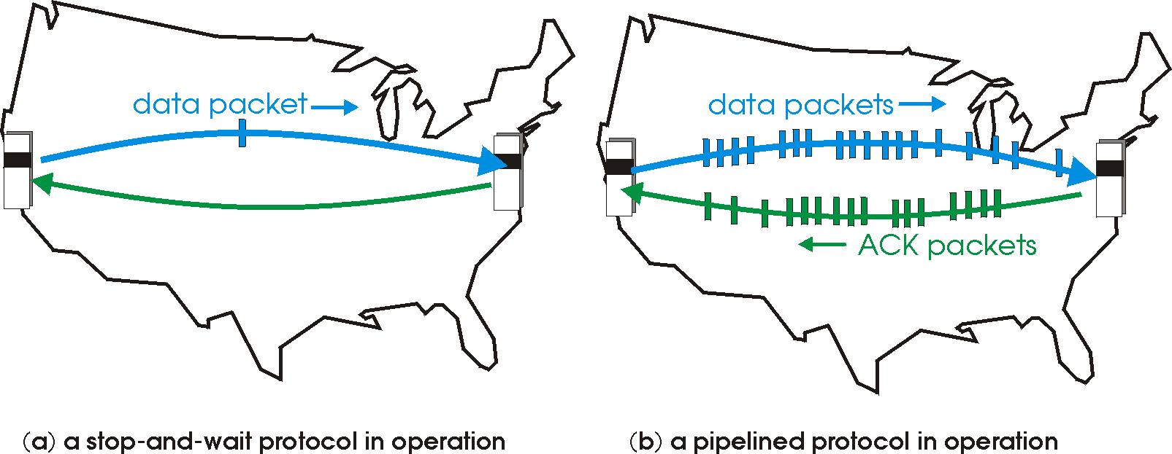

rdt3.0: pipelined protocols operation
pipelining: sender allows multiple, “in-flight”, yet-to-be-acknowledged packets
range of sequence numbers must be increased
buffering at sender and/or receiver

Slide 20
Pipelining: increased utilization
sender
receiver
first packet bit transmitted, t = 0
last bit transmitted, t = L / R
first packet bit arrives
RTT
last packet bit arrives, send ACK
last bit of 2nd packet arrives, send ACK
last bit of 3rd packet arrives, send ACK
ACK arrives, send next
packet, t = RTT + L / R
3-packet pipelining increases
utilization by a factor of 3!
Notes:
two generic forms of pipelined protocols: go-Back-N, selective repeat

Slide 21
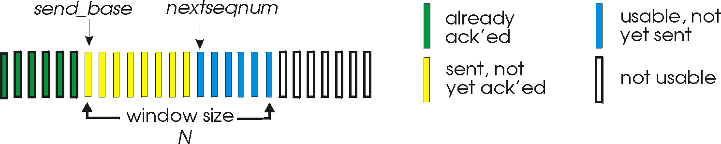
Go-Back-N: sender
sender: “window” of up to N, consecutive transmitted but unACKed pkts
k-bit seq # in pkt header
cumulative ACK: ACK(n): ACKs all packets up to, including seq # n
on receiving ACK(n): move window forward to begin at n+1
timer for oldest in-flight packet
timeout(n): retransmit packet n and all higher seq # packets in window
Notes:
window size of 14, 8 have been sent but are not yet acknowledged, 6 sequence numbers are available for us. In window, but no calls from above to use them.
Note – we’ll skip the Go-Back-N FSM specification you can check that out in PowerPoint slides or book)
TCP uses cumulative ACK

Slide 22
Go-Back-N: receiver
ACK-only: always send ACK for correctly-received packet so far, with highest in-order seq #
may generate duplicate ACKs
need only remember rcv_base
on receipt of out-of-order packet:
can discard (don’t buffer) or buffer: an implementation decision
re-ACK pkt with highest in-order seq #
Receiver view of sequence number space:
received and ACKed
…
…
Out-of-order: received but not ACKed
rcv_base
Not received
Notes:
Note – we’ll skip the Go-Back-N FSM specification (actually it’s

Slide 23
Go-Back-N in action
sender window (N=4)
sender
receiver
0 1 2 3 4 5 6 7 8
send pkt0
send pkt1
send pkt2
send pkt3
(wait)
0 1 2 3 4 5 6 7 8
receive pkt0, send ack0
receive pkt1, send ack1
receive pkt3, discard,
(re)send ack1
0 1 2 3 4 5 6 7 8
X
0 1 2 3 4 5 6 7 8
loss
0 1 2 3 4 5 6 7 8
rcv ack0, send pkt4
0 1 2 3 4 5 6 7 8
rcv ack1, send pkt5
receive pkt4, discard,
(re)send ack1
ignore duplicate ACK
receive pkt5, discard,
(re)send ack1
pkt 2 timeout
0 1 2 3 4 5 6 7 8
send pkt2
send pkt3
send pkt4
send pkt5
0 1 2 3 4 5 6 7 8
0 1 2 3 4 5 6 7 8
rcv pkt2, deliver, send ack2
rcv pkt3, deliver, send ack3
rcv pkt4, deliver, send ack4
rcv pkt5, deliver, send ack5
0 1 2 3 4 5 6 7 8
Notes:
Let’s skip FSM specification for GBN – check out the book or ppt – and let’s watch GBN sender and receivers in action.
Let assume a window size of 4. at t=0, sender sends packets 0, 1, 2 3, 4, and packet 2 will be lost
At the receiver:
Packet 0 received ACK0 generated
Packet 1 received ACK1 generated
Packet 2 is lost, and so when packet 3 is received, ACK 1 is sent – that’s the cumulative ACK, re-Acknowledging the receipt of packet 1. and in this implementation packet 3 is discarded

Slide 24
Selective repeat: the approach
pipelining: multiple packets in flight
receiver individually ACKs all correctly received packets
buffers packets, as needed, for in-order delivery to upper layer
sender:
maintains (conceptually) a timer for each unACKed pkt
timeout: retransmits single unACKed packet associated with timeout
maintains (conceptually) “window” over N consecutive seq #s
limits pipelined, “in flight” packets to be within this window
Notes:
An important mechanism of GBN was the use of the cumulative acknowledgements, and as we mentioned, cumulative ACKs are used in TCP
An alternate ACK mechanism would be for the receiver to individually acknowledge specific packets as they are received. This mechanism is at the heart of the Selective repeat protocol.

Slide 25
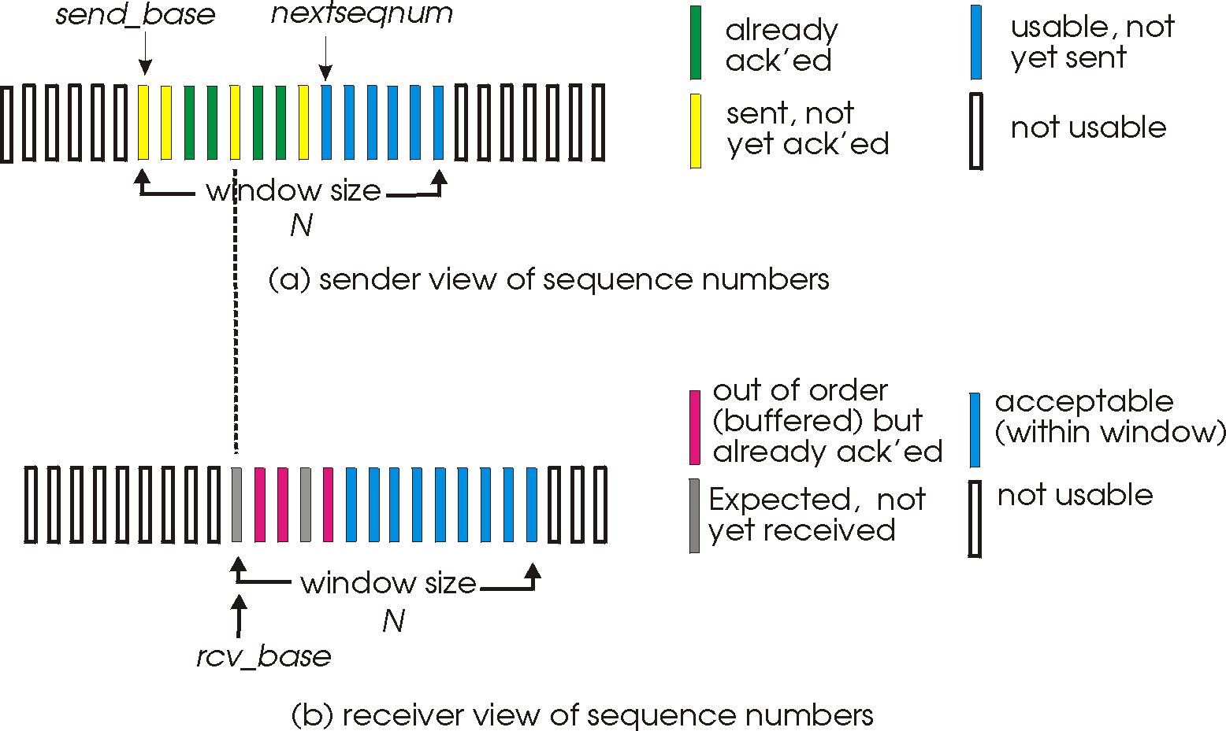
Selective repeat: sender, receiver windows

Slide 26
Selective repeat: sender and receiver
sender
receiver
data from above:
if next available seq # in window, send packet
timeout(n):
resend packet n, restart timer
ACK(n) in [sendbase,sendbase+N-1]:
mark packet n as received
if n smallest unACKed packet, advance window base to next unACKed seq #
packet n in [rcvbase, rcvbase+N-1]
send ACK(n)
out-of-order: buffer
in-order: deliver (also deliver buffered, in-order packets), advance window to next not-yet-received packet
packet n in [rcvbase-N,rcvbase-1]
ACK(n)
otherwise:
ignore
Notes:
If the packet is in order, its data will be delivered, as will any buffered data that can now be delivered in order

Slide 27
Selective Repeat in action
sender window (N=4)
sender
receiver
0 1 2 3 4 5 6 7 8
send pkt0
send pkt1
send pkt2
send pkt3
(wait)
0 1 2 3 4 5 6 7 8
receive pkt0, send ack0
receive pkt1, send ack1
receive pkt3, buffer,
send ack3
0 1 2 3 4 5 6 7 8
X
0 1 2 3 4 5 6 7 8
loss
0 1 2 3 4 5 6 7 8
rcv ack0, send pkt4
0 1 2 3 4 5 6 7 8
rcv ack1, send pkt5
receive pkt4, buffer,
send ack4
record ack3 arrived
receive pkt5, buffer,
send ack5
pkt 2 timeout
0 1 2 3 4 5 6 7 8
send pkt2
(but not 3,4,5)
0 1 2 3 4 5 6 7 8
0 1 2 3 4 5 6 7 8
rcv pkt2; deliver pkt2,
pkt3, pkt4, pkt5; send ack2
0 1 2 3 4 5 6 7 8
Q: what happens when ack2 arrives?

Slide 28
Selective repeat: a dilemma!
sender window
(after receipt)
receiver window
(after receipt)
0 1 2 3 0 1 2
pkt0
0 1 2 3 0 1 2
pkt1
0 1 2 3 0 1 2
0 1 2 3 0 1 2
pkt2
0 1 2 3 0 1 2
example:
seq #s: 0, 1, 2, 3 (base 4 counting)
window size=3
0 1 2 3 0 1 2
0 1 2 3 0 1 2
pkt3
X
0 1 2 3 0 1 2
pkt0
will accept packet
with seq number 0
(a) no problem
0 1 2 3 0 1 2
pkt0
0 1 2 3 0 1 2
pkt1
0 1 2 3 0 1 2
0 1 2 3 0 1 2
pkt2
X
0 1 2 3 0 1 2
X
0 1 2 3 0 1 2
X
timeout
retransmit pkt0
0 1 2 3 0 1 2
pkt0
will accept packet
with seq number 0
(b) oops!

Slide 29

Selective repeat: a dilemma!
sender window
(after receipt)
receiver window
(after receipt)
0 1 2 3 0 1 2
pkt0
0 1 2 3 0 1 2
pkt1
0 1 2 3 0 1 2
0 1 2 3 0 1 2
pkt2
0 1 2 3 0 1 2
example:
seq #s: 0, 1, 2, 3 (base 4 counting)
window size=3
0 1 2 3 0 1 2
0 1 2 3 0 1 2
pkt3
X
0 1 2 3 0 1 2
receiver can’t see sender side
receiver behavior identical in both cases!
something’s (very) wrong!
pkt0
will accept packet
with seq number 0
(a) no problem
Q: what relationship is needed between sequence # size and window size to avoid problem in scenario (b)?
pkt0
0 1 2 3 0 1 2
0 1 2 3 0 1 2
pkt1
0 1 2 3 0 1 2
0 1 2 3 0 1 2
pkt2
X
0 1 2 3 0 1 2
X
0 1 2 3 0 1 2
X
timeout
retransmit pkt0
0 1 2 3 0 1 2
pkt0
will accept packet
with seq number 0
(b) oops!

Slide 30
Thank You!

